Slide 3
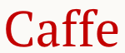

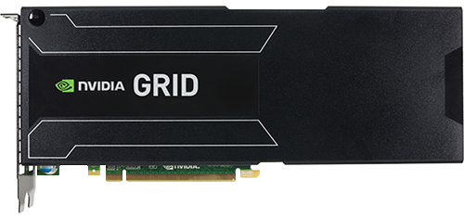
US
EU
AsiaPacific
…
AWS EC2 Spot Instance Pool with GPU Devices
M-2
M-6
P-2
M-1
M-5
Permanent Storage
Instance Arbitrator
…
M-4
Instance Recommender
M-3
Spot Price Monitor
P-1
EC2 Spot Instance Price Information
Spot Instance Orchestrator

Slide 4
AZ-1
AZ-2
AZ-3
on-demand instance price
LOWER
GPU
Spot Instance Price
T₀
T₁
T₂
T₃
T₄ : billing period
T₅
T₆
T₇
T₈
Time

Slide 5
PriceChecker to RDS
Recommender to SQS
Checkpoint data to S3
EC2 user-script to start a task
EC2 copy image to copy across regions

Slide 6







US
EU
AsiaPacific
Spot instance
AMI
Spot instance
AMI
Spot instance
AMI
Amazon API Gateway
Amazon S3
AWS
Lambda
Amazon
CloudWatch
Amazon DynamoDB
Spot Price History
AWS
Lambda

Slide 7
US
EU
AsiaPacific
AMI
Amazon S3
Spot instance
Spot instance
AMI
Spot instance
AMI
Amazon API Gateway
Amazon API Gateway
AWS
Lambda
Amazon
CloudWatch
AWS
Lambda
AWS
Lambda
Spot Price History
Amazon DynamoDB

Slide 8


AWS
Lambda
AWS
Lambda
AWS
Lambda
US
EU
AsiaPacific
AMI
Amazon S3
Spot instance
Spot instance
AMI
Spot instance
AMI
minutely
Instance Arbitrator
AWS
Lambda
Amazon
CloudWatch
Amazon API Gateway
Spot Price Monitor
hourly
Amazon
CloudWatch
AWS
Lambda
Spot Price History
Amazon Kinesis
Amazon
Machine Learning
Amazon DynamoDB
Instance Recommender

Slide 9
US
EU
AsiaPacific
Spot instance
AMI
Spot instance
AMI
Spot instance
AMI
Amazon S3
Amazon API Gateway
AWS
Lambda
Spot Price History
Amazon DynamoDB
Amazon Kinesis
Amazon
Machine Learning
AWS
Lambda

